Slide 1
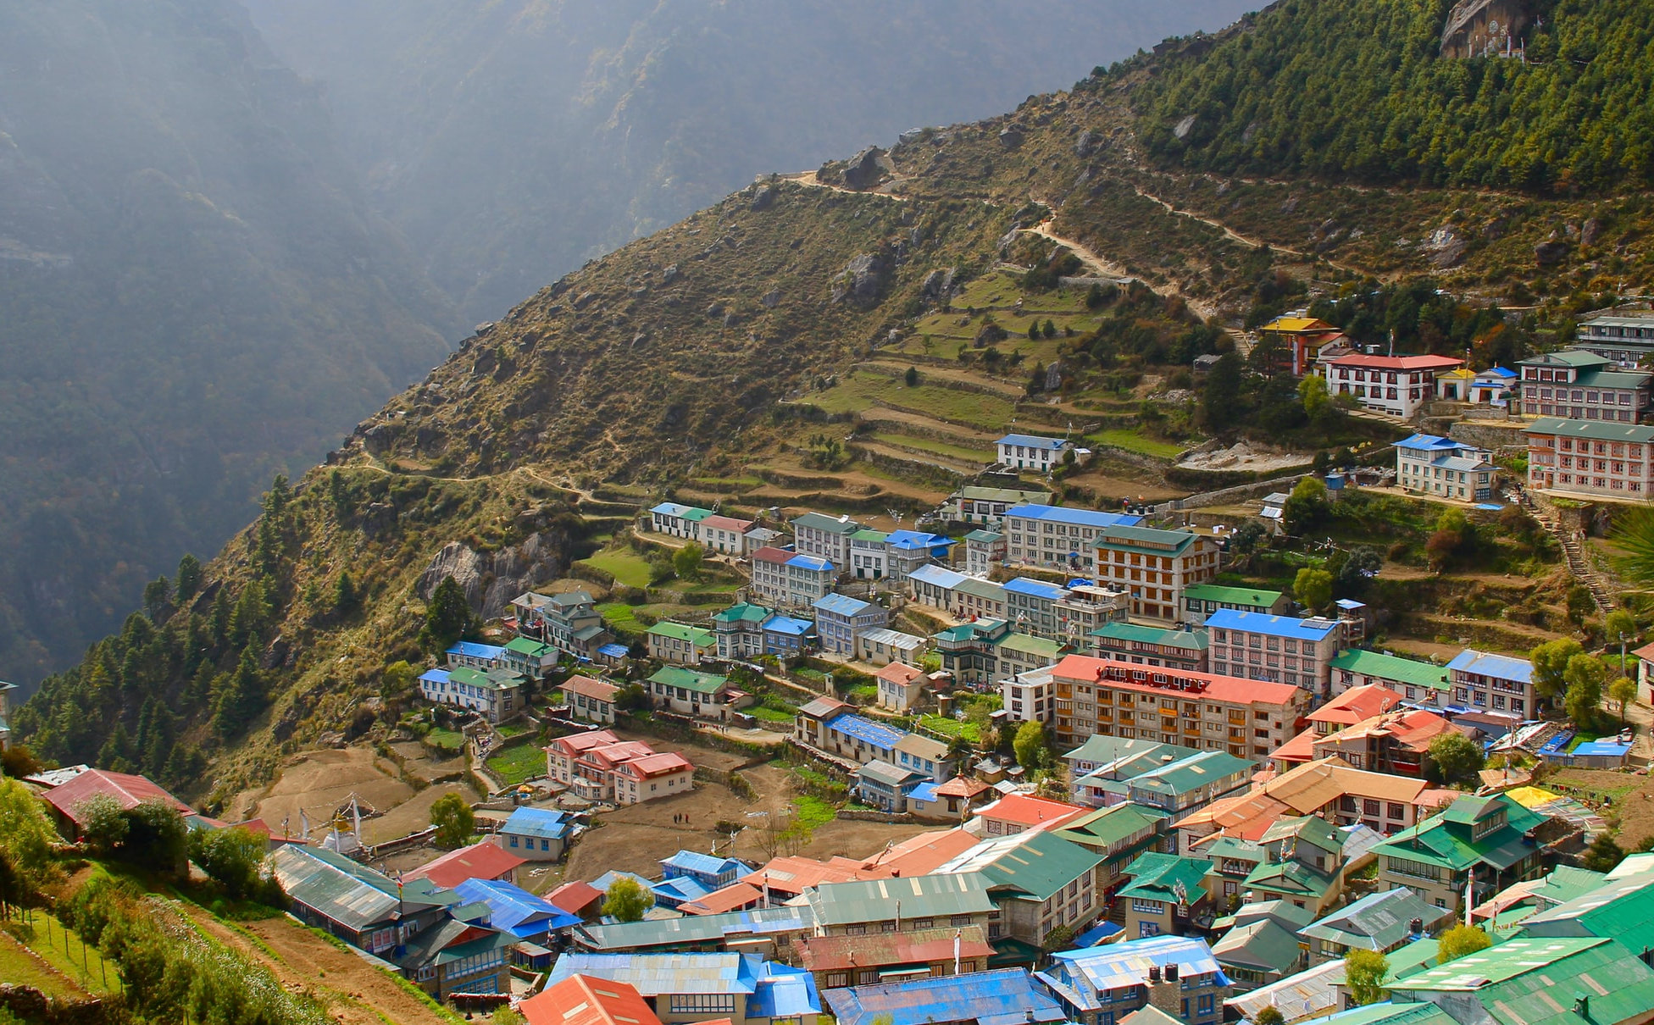
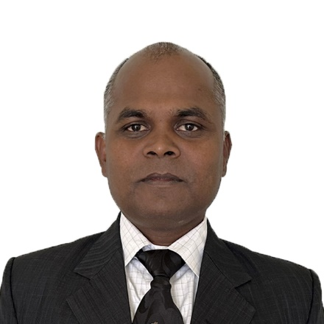
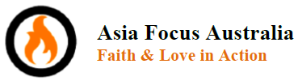
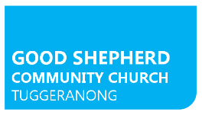
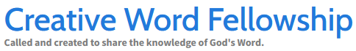
His-Story in the making
The growth of the gospel in Nepal
Pastor
Rabindra
Das
Adelaide Tour
28th Mar – Presentations and conversations
@ Glandore Lutheran Church 0930-1130 & 1900-2100
29th Mar – Zone Fraternal @ Glandore church 1200-1500 – Contact Pastor Guntars
1st Apr – CWF afternoon session 2-5pm
@ St Marks Lutheran Church Underdale
2nd Apr – Presentations and conversations in the Barossa – more details to come.
Contact for further details: Pastor Guntars Baikovs - 0407281333
Pastor Rabindra is also touring Canberra and Brisbane
Photo by Kalle Kortelainen on Unsplash
Have you read the book of Acts and thought that the meteoric growth of the church is only history? It's easy to think that way in post-Christian, post-covid Australia. But there is a church movement in Nepal that is experiencing significant, ongoing growth today through conversion. Come and meet the leader of Nepal's Living Stone Ministries, Pastor Rabindra Das, as he shares the story of what God is doing right now in this Himalayan nation through a church network that takes a holistic approach to sharing the gospel.
Asia Focus Australia, in partnership with Good Shepherd Community Church, a Lutheran church in Canberra, and Creative Word Fellowship, a Lutheran teaching mission that has provided theological education to pastors in Nepal, are proud to bring Pastor Rabindra on tour to Australia.
www.asiafocus.org.au | www.tuggeranong.lutheran.org.au | www.cwfellowship.net

