Slide 1

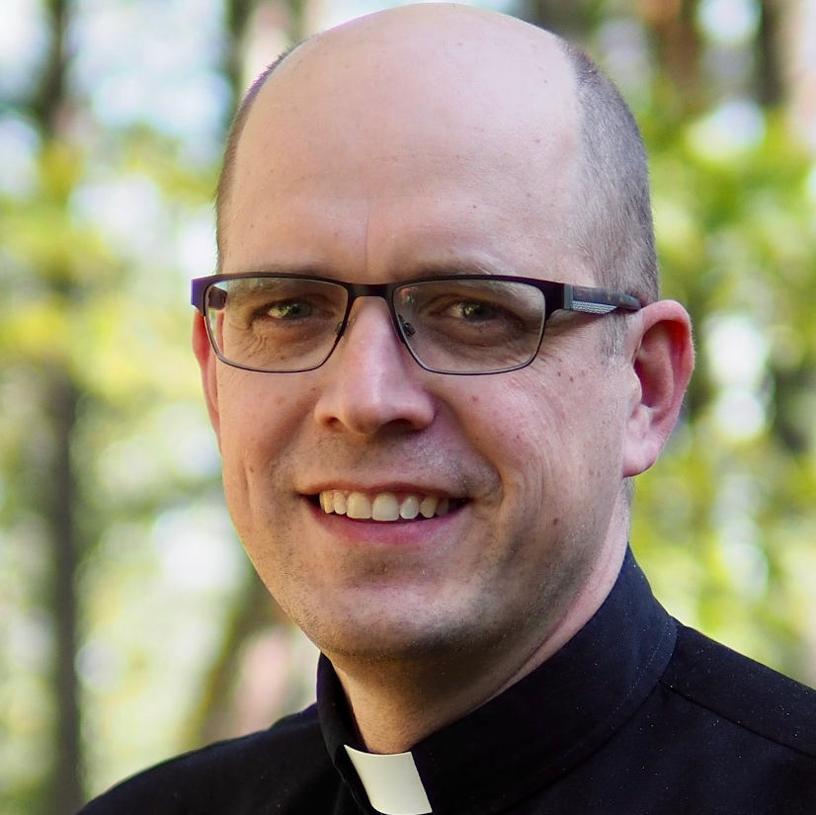
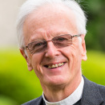
CONFESSING CHRIST
PRESENTED BY:
CREATIVE WORD FELLOWSHIP
Join Bishop Juhana Pohjola and Rev Dr John Stephenson
as they discuss contemporary issues within Lutheranism worldwide.
Hamilton, Victoria
Session 1: Wed 29th Nov 7-9.30pm
Session 2: Thurs 30th Nov 7-9.30pm
Tea and coffee provided
The Lutheran Church of the Good Shepherd
12 Thompson Street, Hamilton, VIC
REGISTRATION ESSENTIAL: cwfellowship.net/events/confessing-christ/

